Slide 1


Miss Wickenden and Mrs McGrath
Welcome you to Year 6!

Slide 2
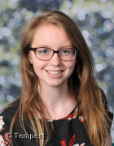
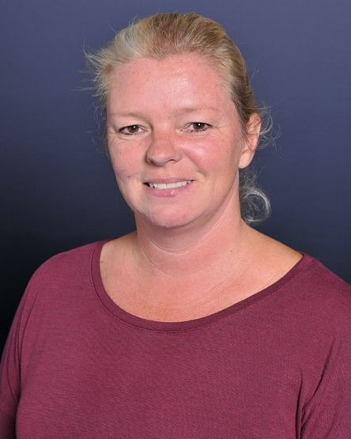
Class Teacher:
Miss Wickenden
Teaching Assistant:
Mrs McGrath

Slide 3
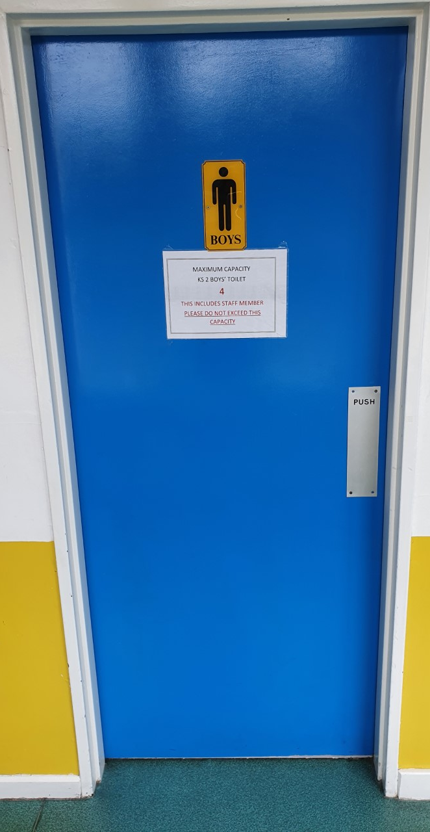
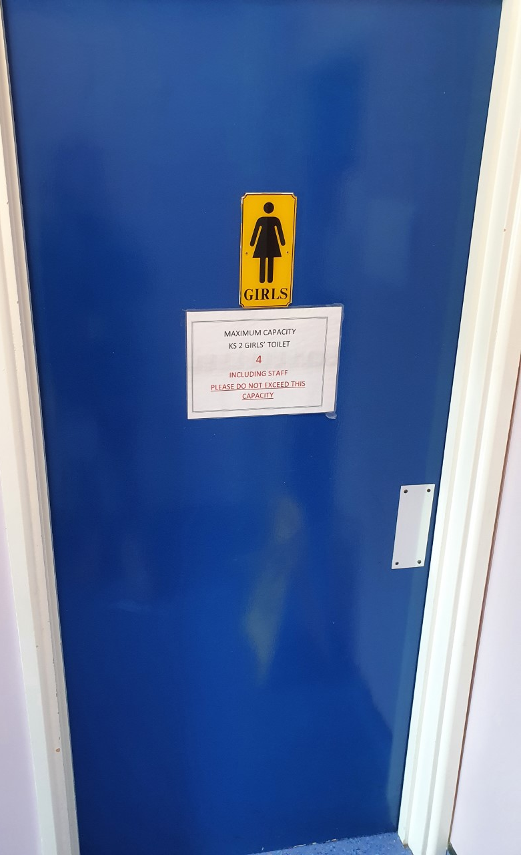
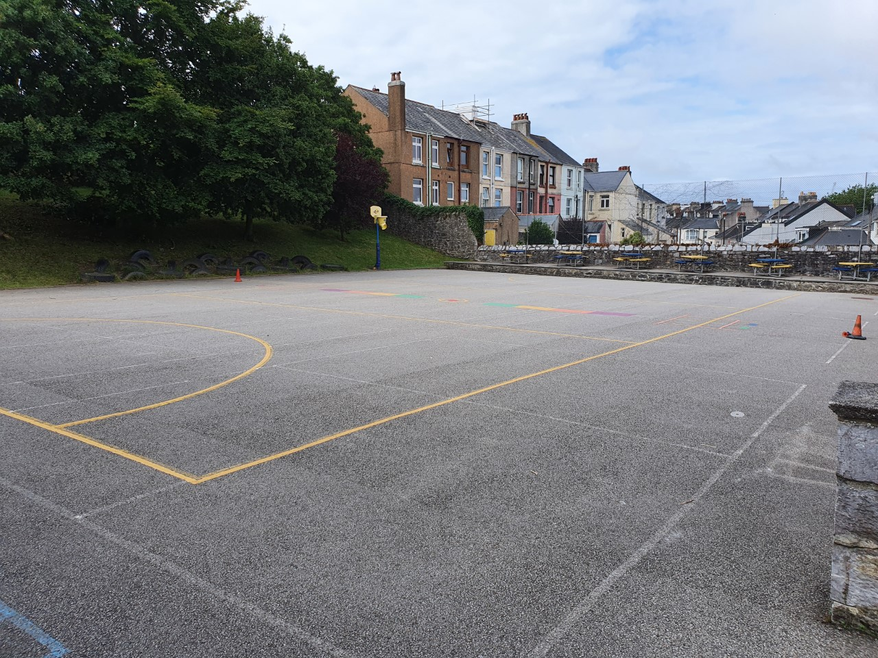

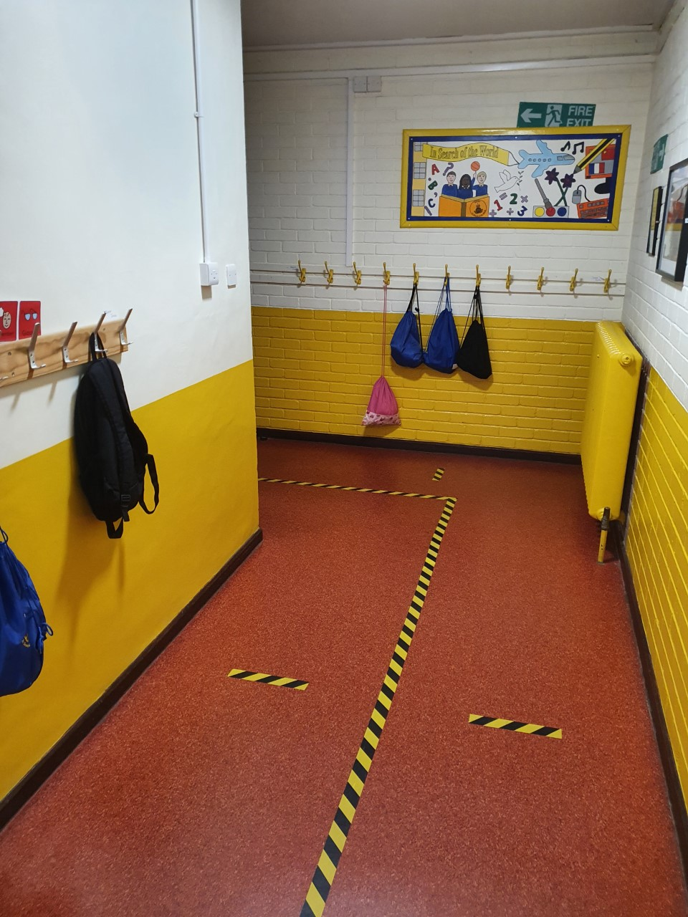
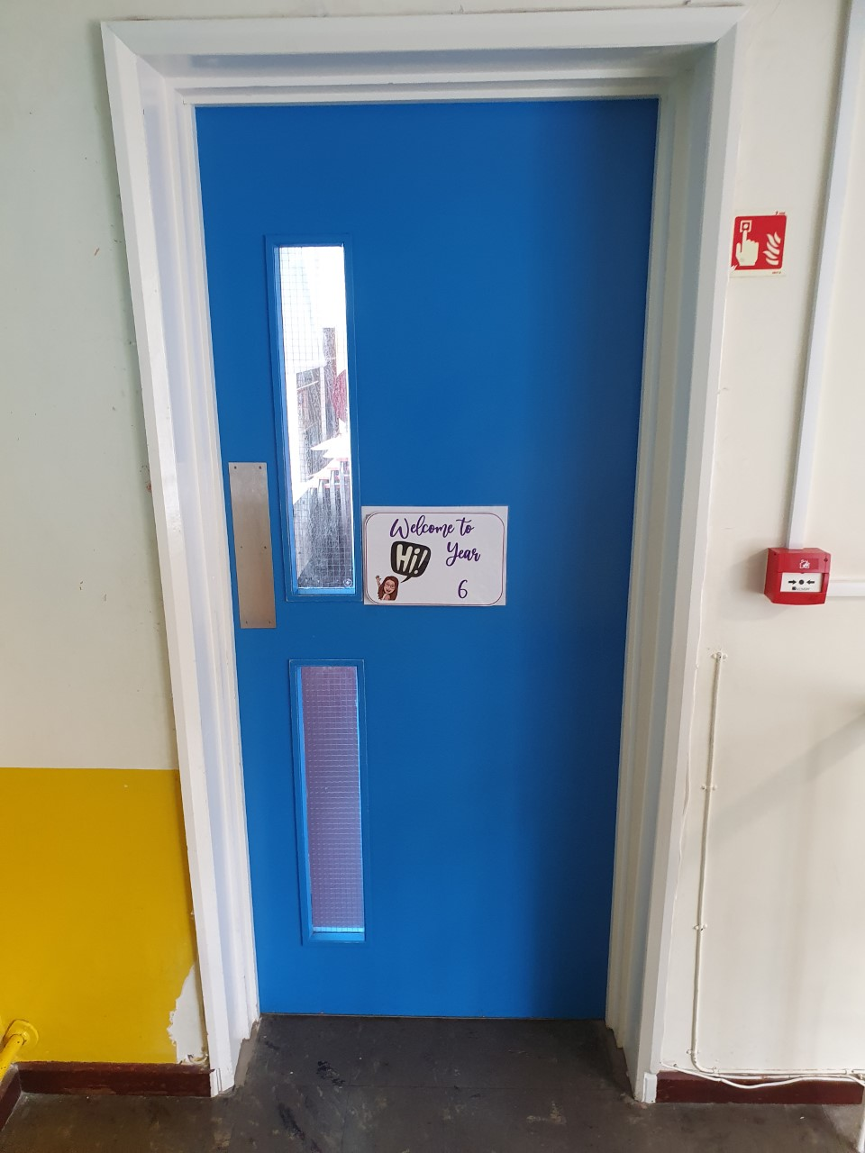
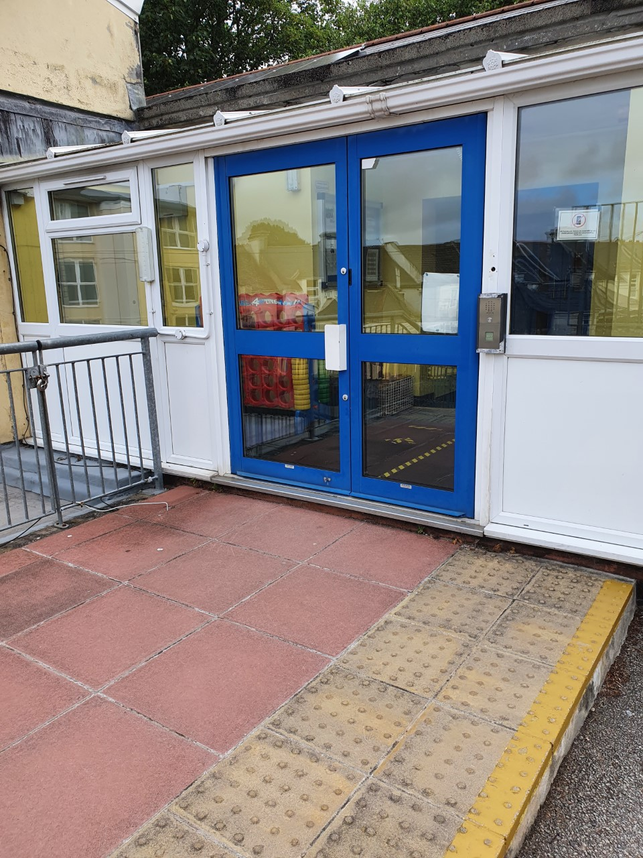
Playground
Toilets
Door to come in
Cloakroom
Year 6 Door

Slide 4
Topics
Term 1 & 2: Ancient Egypt
Terms 3 & 4: Chronology
Terms 5 & 6: Our Changing Coasts

Slide 5

Spellings are tested every Friday and new spellings will be given after.
Each day, the children will read in class in their ERIC groups which will focus on developing their reading skills. On Friday’s the children will be given the opportunity to read for pleasure.

Slide 6
Rewards
For following our Year 6 Rules for Learning and producing brilliant pieces of work, rewards are given in the form of marbles. If the children work hard and fill the marble jar they can have a whole class prize of their choosing.
The children will also be given special ‘Miss W saw that…’ cards, which can be about all aspects of school life!
Headteacher’s award will be given for exceptional work a high standard of presentation.
ROARR certificates will be awarded to the children that demonstrate a learning dispositions: resourceful; open; aspirational; resilient and reflective.
There is also an additional reward for reading – for every book that a child reads, they have the chance to collect cool stickers on a bookmark ☺

Slide 7
Homework
Home learning will be set for the term and should be handed in when it is completed. If completed to a good standard, children will be rewarded a marble for the jar.
Homework will consist of a variety of tasks such as a topic project, writing or maths problem solving tasks.
Children are expected to read daily and practice the spellings given out every Friday. When your child reads with an adult or independently, please make a note of this in their reading record.

Slide 8
Pencil cases won’t be necessary next year. We will provide all the equipment they need ☺
Book bags (with reading record and spelling journals) need to be in school everyday please.

Slide 9
Website, Facebook Group and Twitter page
Check out our website, Facebook group and Twitter page where we will be putting up pictures and videos of the children’s learning throughout the year.
Drake Primary Academy website

Slide 10
We look forward to seeing you in September.
You can contact me throughout the school year at:
year6@drakeprimaryschool.onmicrosoft.com
Please don’t hesitate to ask me any questions.

